Slide 1
6th Grade Science With Mr. Philip Bertling
Subtitle

Slide 2
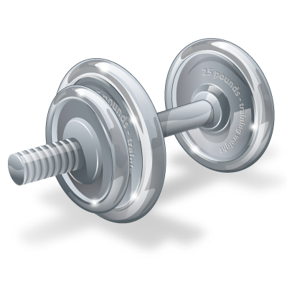
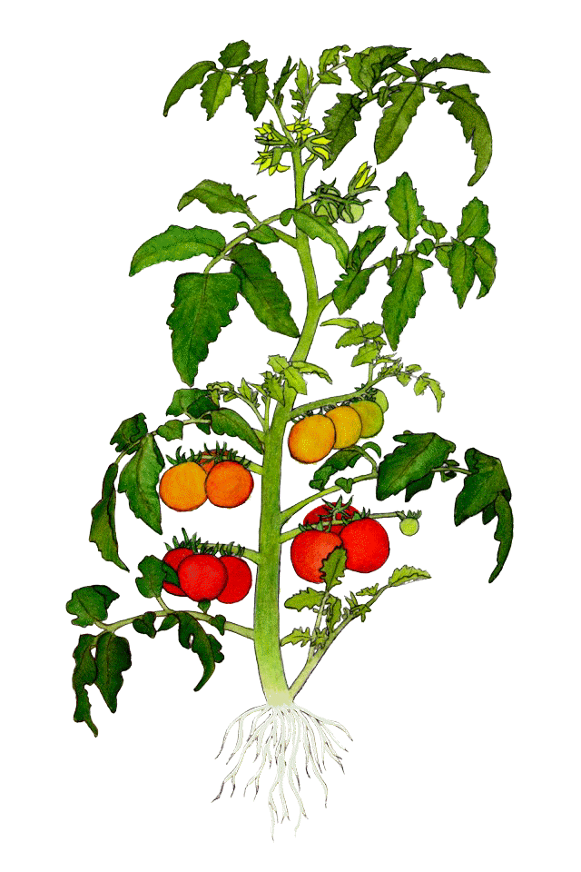
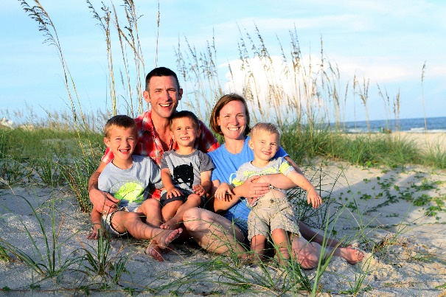
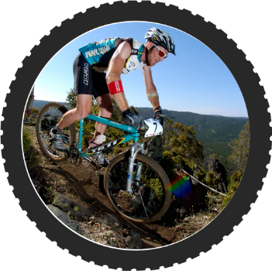
About Me…
Iowa Born & Raised
Augusta, GA
11 Years
5th Generation Iowa Grad
What I Do For Fun
My Family
Arizona
June 2017

Slide 3
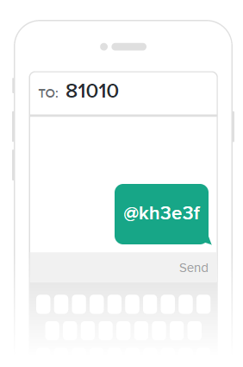
Contact Information
pbertling@Kyrene.org or call
(480) 541-6000
Remind App
Text @kh3e3f to the number 81010
They’ll receive a welcome text from Remind. If anyone has trouble with 81010, they can try texting @kh3e3f to (706) 813-4182

Slide 4
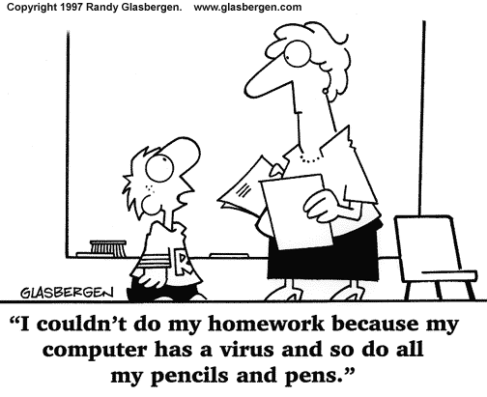
Homework
Planners
Whiteboard
Website
https://tinyurl.com/Bertling6th

Slide 5
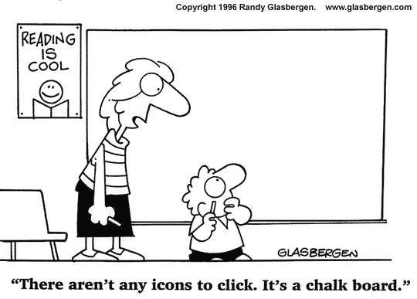
Homework
It’s important to check the whiteboard everyday.
Class assignments will be written in blue,
homework assignments will be written in green,
and tests will be written in red.

Slide 6
Projects
Projects
Projects are marked down 10% each day for three days. After three days it’s a zero.
Test Study Guides and Notes are provided for test. In most cases the study guides or notes are given a week before the tests.
Homework and Class work
Full credit can be earned for work submitted on time.
Any work submitted after one day will receive 1/2 credit.
Any work two or more days late will receive a zero.

Slide 7
Grades
Grades are weighted.
80% Assessment
Tests & Quizzes
Projects
Lab Reports
20% Class Work and Homework

Slide 8
My Personal Website
http://altsci.weebly.com/
Here you will find videos, I’ve personally created, for students to watch prior to class or post class & many additional resources.
I do this for the following reasons…
> It maximizes my lab time if students come in prepared for lab to be conducted immediately with notes setup and background information already present.
> It allows me to differentiate to accommodate student needs and also provides support when students are absent.
> Parents and guardians can watch videos to see what their child is learning and provide their own additional support.

Slide 9
If Absent
Students who are absent should check the website or their agendas for details. You receive one day to make up work for each day you are absent. We do make exceptions.
If students are gone for a few days please notify the teachers and office ahead of time.

Slide 10
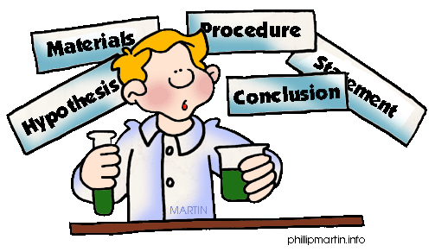
When Using The Scientific Method We…
Question
Plan and conduct investigations
Use appropriate tools and techniques to gather data
Think critically and logically about relationships between evidence and explanations
Communicate results

Slide 11
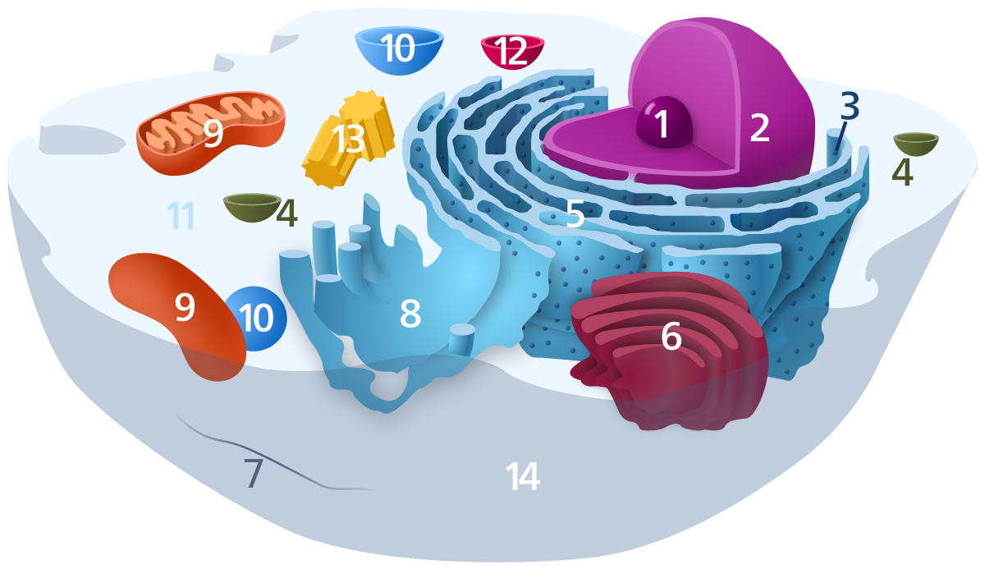
1st Quarter
Structure & Function in Living Systems

Slide 12
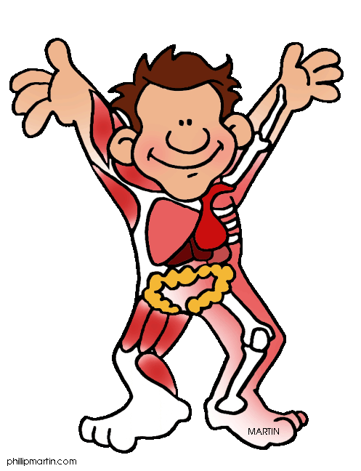
2nd Quarter
Human Body
Plants

Slide 13
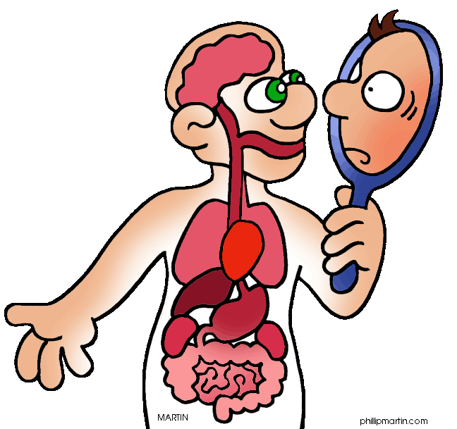
2nd Quarter
Animals: Relate and describe the following structures of living organisms to their functions:
Respiration – gills, lungs
Digestion – stomach, intestines
Circulation – heart, veins, arteries, capillaries
Locomotion – muscles, skeleton

Slide 14
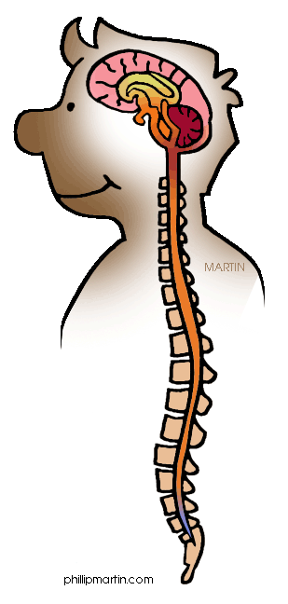
2nd Quarter
Describe how the nervous system interacts with these systems:
Respiration
Digestion
Circulation
Locomotion
Explain how the human body contracts and fights illnesses and diseases.

Slide 15
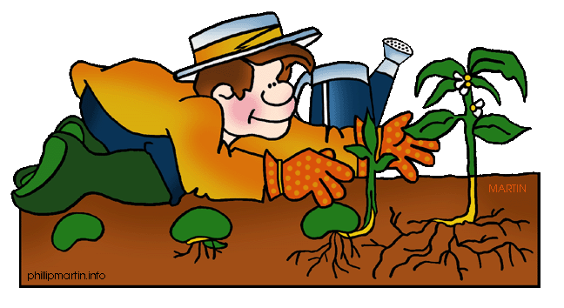
2nd Quarter
Plants: Relate and describe the following structures of living organisms to their functions
Transpiration – stomata, roots, xylem, phloem
Absorption – roots, xylem, phloem
Response to stimulus (phototropism, hydrotropism, geotropism) – roots, xylem, phloem

Slide 16
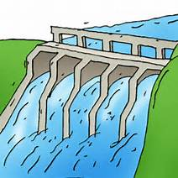
3rd Quarter
Energy & Science and It’s Impact on Society
Renewable
Nonrenewable
Transfer of energy

Slide 17
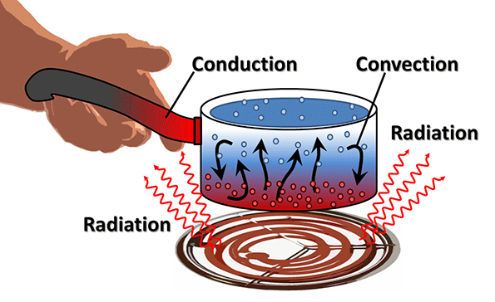
3rd Quarter
Energy
Renewable and nonrenewable resources
Ways energy can be stored and transformed
How thermal energy can be transferred

Slide 18
3rd Quarter
Compare the pros and cons of alternate energy sources and the technology behind them.
Explain why all energy sources should be conserved.

Slide 19
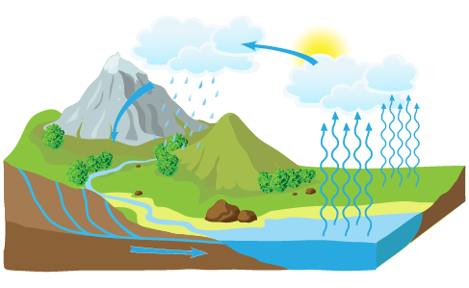
4th Quarter
Earth’s Processes and Systems
Describe layers of the atmosphere
Structures of lakes, rivers, oceans
Water cycle
Weather

Slide 20
4th Quarter
Science in Personal and Social Perspectives
Describe the interactions between human populations, natural hazards, and the environment.
Understand the impact of technology.

